Slide 1

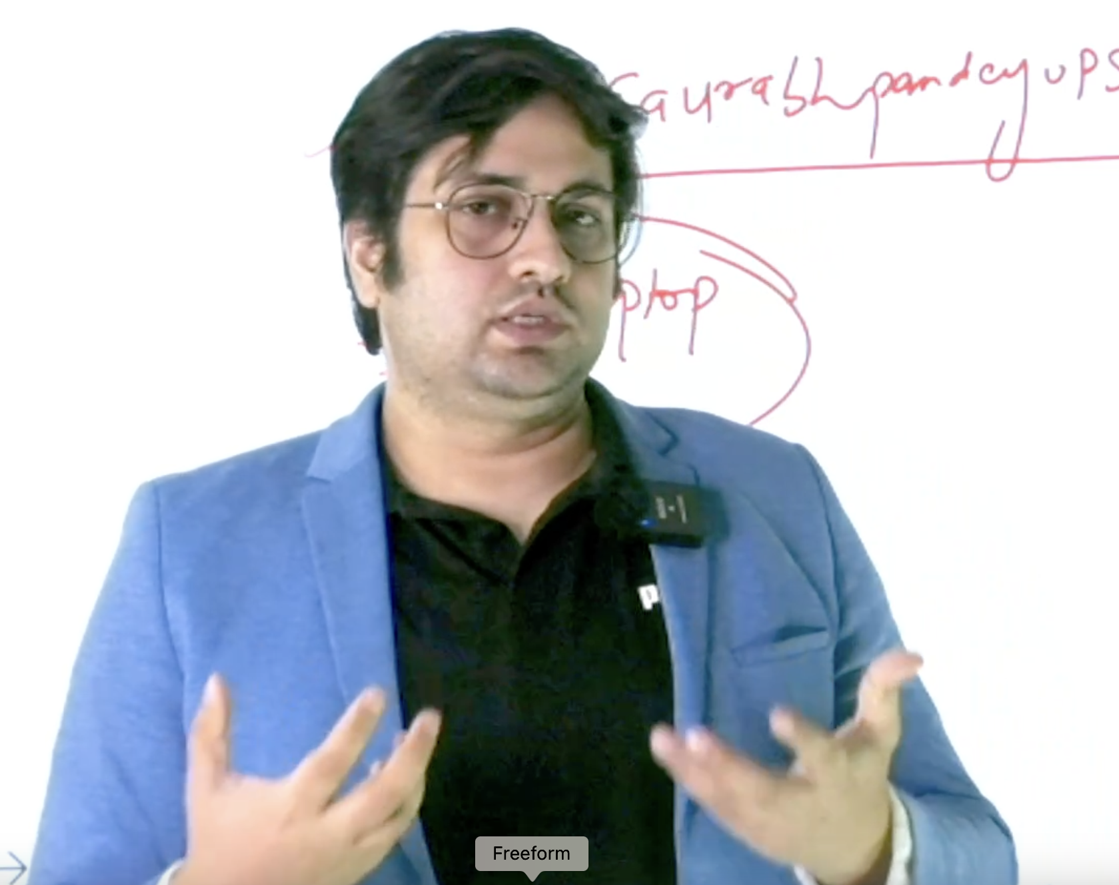

Topics - MINDS MAPS included
Topic- What is DNA PROFILING??
Trichophyton indotineae /rDNA
The Internal Transcribed Spacer (ITS) region
Monetary policy and unemployment
Development on himalayan Region
Mains
By saurabh Pandey

Slide 2
Target Mains -2024/25 -
Q What impact climate change has on monetary policy ??
Connect with sir
9057921649
send your answer - Saurabh pandey upsc telegram channel

Slide 3
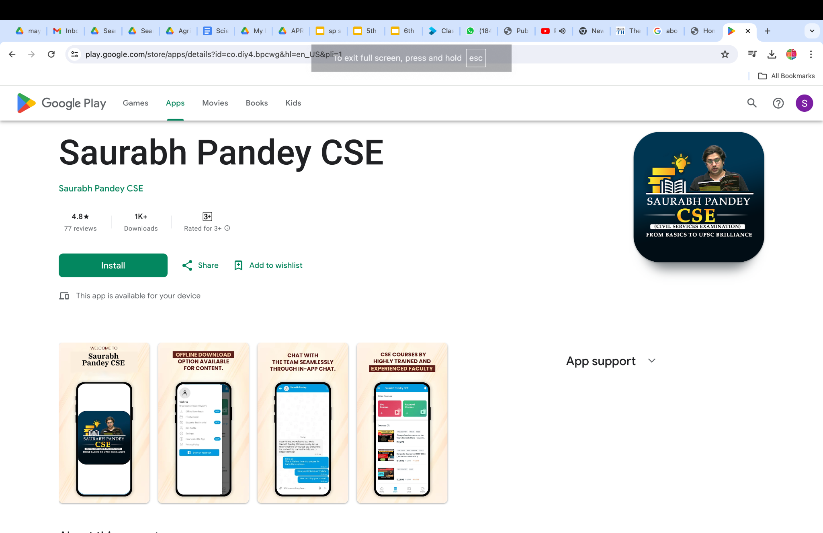

Slide 4
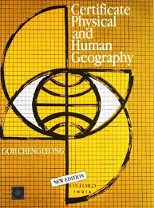






ALL Advance books for upsc IN ONE COURSE
Starting 1st june
Visit - saurabhpandeyupsc.com
Msg - 9057921649

Slide 5
Topic- What is DNA PROFILING??
What is DNA Profiling?
Definition: DNA profiling, also known as DNA fingerprinting, is a forensic technique used to identify individuals based on their unique DNA characteristics. It involves comparing DNA samples to assess the likelihood of a match.
Principles: DNA profiling relies on the fact that no two individuals (except identical twins) have the same DNA sequence, making it a powerful tool for identification and criminal investigations.
Historical Context: The concept of DNA profiling was first introduced by Sir Alec Jeffreys in the 1980s, revolutionizing forensic science and genetic analysis.

Slide 6
: Process of DNA Profiling
Sample Collection: DNA samples can be obtained from various sources, such as blood, hair, saliva, or other bodily fluids, and even from crime scene evidence.
DNA Analysis: The collected samples undergo a series of tests and techniques to extract and evaluate the genetic information contained within an individual's cells.
Creating a Profile: Through Polymerase Chain Reaction (PCR) analysis, a unique DNA profile is created, which can be used for identification and comparison.

Slide 7
Importance in Forensic Investigations
Criminal Investigations: DNA profiling is a crucial tool in solving criminal cases, helping to link suspects to a crime scene or identify potential perpetrators.
Establishing Identity: It is used to establish the identity of individuals from samples of DNA, aiding in paternity tests, custody disputes, and missing persons cases.
Limitations: Sometimes, the DNA from crime scene evidence is in a very small quantity, poorly preserved, or highly degraded, resulting in partial DNA profiles.

Slide 8
applications of DNA Profiling
: Forensic Applications
Crime Scene Analysis: DNA profiling is used to identify potential suspects and link them to a crime, aiding in the resolution of criminal cases.
Forensic Medicine: It plays a crucial role in establishing the custody of a child through paternity testing and resolving other legal and medical issues.
State-of-the-Art Facilities: Forensic DNA profiling facilities provide advanced DNA analysis services for both human and nonhuman DNA.

Slide 9
Medical and Research Applications
Diagnosing Disorders: DNA profiling is used to diagnose inherited disorders and human diseases, contributing to advancements in medical diagnostics and treatment.
Research Advancements: It continues to play a pivotal role in genetic research, including studies on population genetics, evolutionary biology, and disease susceptibility.
Future Possibilities: The list of additional uses for DNA profiling continues to grow, with potential applications in personalized medicine and precision healthcare.

Slide 10
Ethical Considerations in DNA Profiling
Informed Consent: Ethical guidelines emphasize the importance of obtaining informed consent for DNA profiling, ensuring respect for individual autonomy and privacy.
Data Security: Safeguarding genetic data from unauthorized access and misuse is a critical ethical consideration in the era of widespread DNA profiling.
Equitable Access: Ensuring equitable access to DNA profiling technologies and services is essential for mitigating disparities and promoting social justice.

Slide 11
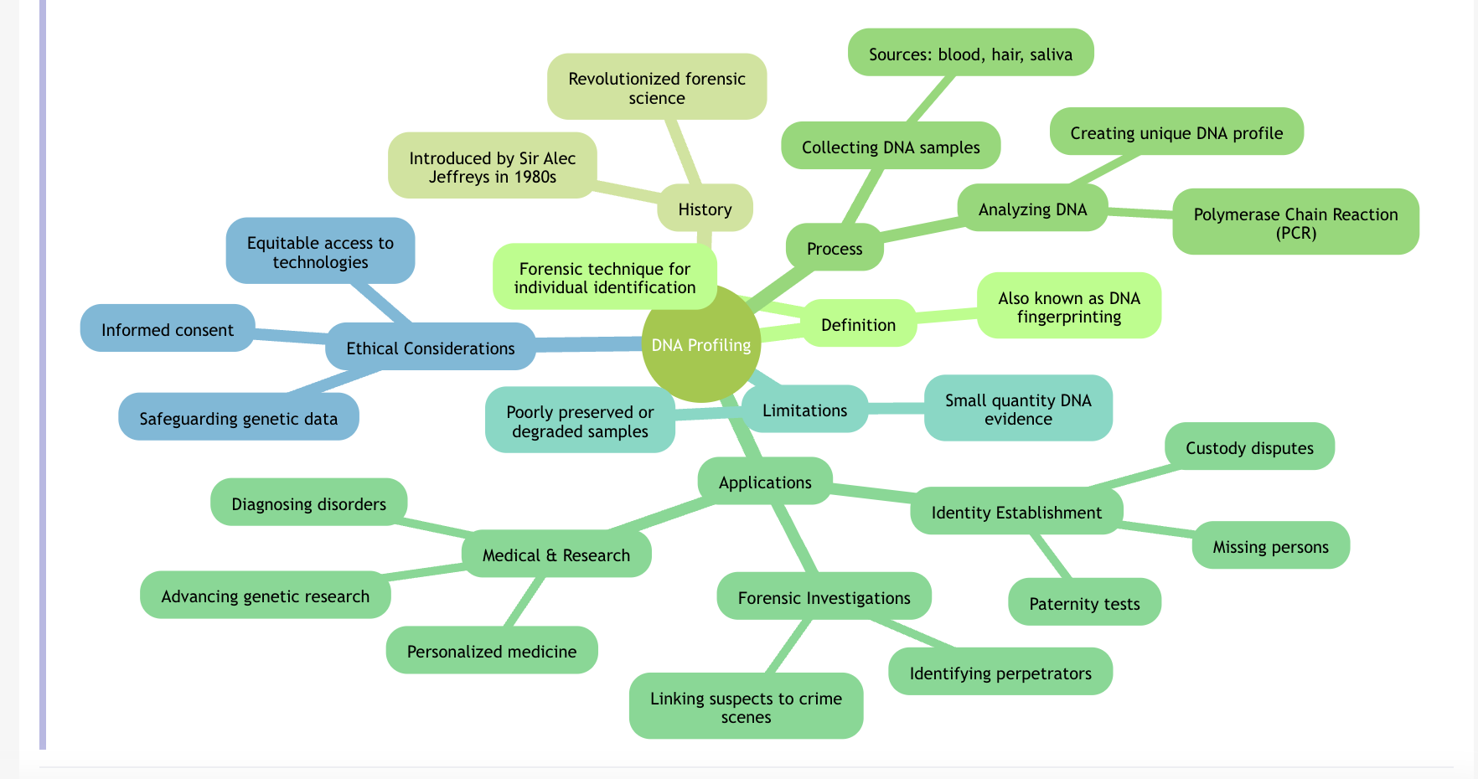

Slide 12
Topic-Trichophyton indotineae /rDNA
Trichophyton indotineae is a species of fungus that belongs to the genus Trichophyton.
This genus includes several species that are known to cause dermatophytosis, a common fungal infection of the skin, hair, and nails in humans and animals. Dermatophytosis is often referred to as ringworm in humans and is characterized by red, itchy, scaly patches on the skin.

Slide 13
Ribosomal DNA (rDNA)
Ribosomal DNA (rDNA) is a type of DNA that codes for ribosomal RNA (rRNA), which is a key component of ribosomes, the cellular structures responsible for protein synthesis.
Ribosomes are found in all living cells, and they are essential for the translation of messenger RNA (mRNA) into proteins, a process known as translation.
The rDNA typically consists of multiple copies of the genes for the different types of rRNA, which include the 5.8S, 18S, and 28S rRNAs in eukaryotes, and the 16S and 23S rRNAs in prokaryotes.

Slide 14
These genes are often arranged in clusters known as rDNA operons or rDNA repeats.
The arrangement and number of rDNA repeats can vary greatly among different organisms. For example, in humans, rDNA is located on the short arm of chromosome 1 and contains hundreds of repeats of the rRNA genes.
The exact number of repeats can differ among individuals.

Slide 15
rDNA is transcribed by RNA polymerase I in eukaryotes to produce the precursor rRNA, which is then processed to yield the mature rRNA molecules.
These rRNA molecules, along with ribosomal proteins, assemble to form the ribosome's subunits.
Due to its conserved nature and the presence of both highly conserved and variable regions, rDNA is often used in molecular biology and systematics for phylogenetic studies to determine the evolutionary relationships among organisms.

Slide 16
It is also used in the identification and classification of species, as the sequence of rDNA can be highly specific to a particular organism or group of organisms.
Additionally, rDNA can be used as a target for genetic engineering techniques, such as CRISPR-Cas9, to modify the expression of rRNA genes, which can affect the efficiency of protein synthesis in cells.

Slide 17
Topic-The Internal Transcribed Spacer (ITS) region
The Internal Transcribed Spacer (ITS) region is a section of DNA that is found in the ribosomal DNA (rDNA) of eukaryotic organisms. It is located between the genes that code for the small and large subunits of ribosomal RNA (rRNA).
The ITS region consists of two spacers, ITS1 and ITS2, which are separated by the 5.8S rRNA gene.
The ITS1 spacer is located between the 18S and the 5.8S rRNA genes, while the ITS2 spacer is situated between the 5.8S and the 28S rRNA genes (in fungi and plants) or the 25S and 18S rRNA genes (in animals).

Slide 18
These spacers are transcribed along with the rRNA genes but are removed during the processing of the rRNA precursor into mature rRNA molecules.
The ITS region is important for several reasons:
Species Identification: The ITS region is often used in molecular systematics and taxonomy for the identification and classification of species. The sequences of ITS1 and ITS2 are highly variable among species, making them useful for distinguishing between closely related organisms.
Phylogenetic Studies: Due to their variability, ITS sequences are valuable for reconstructing phylogenetic relationships among species and higher taxonomic groups. They provide insights into the evolutionary history and diversification of eukaryotic lineages.

Slide 19
Barcoding: The ITS region, particularly ITS2, is used as a barcode for fungal identification in the field of mycology. It is part of the standard for fungal DNA barcoding recommended by the Consortium for the Barcode of Life (CBOL).
Secondary Structure: The ITS regions can form complex secondary structures that may play a role in the regulation of rRNA processing and translation.
Molecular Markers: ITS sequences are commonly used as molecular markers in ecological studies to assess biodiversity and community composition, especially in microbial ecology.

Slide 20
Genetic Engineering: In genetic engineering, the ITS region can be targeted for the insertion of foreign DNA into the rDNA repeat, which can affect the expression of rRNA genes and, consequently, the efficiency of protein synthesis.
The ITS region is an essential tool in molecular biology, providing researchers with a powerful means to identify, classify, and study the evolutionary relationships among eukaryotic organisms.

Slide 21
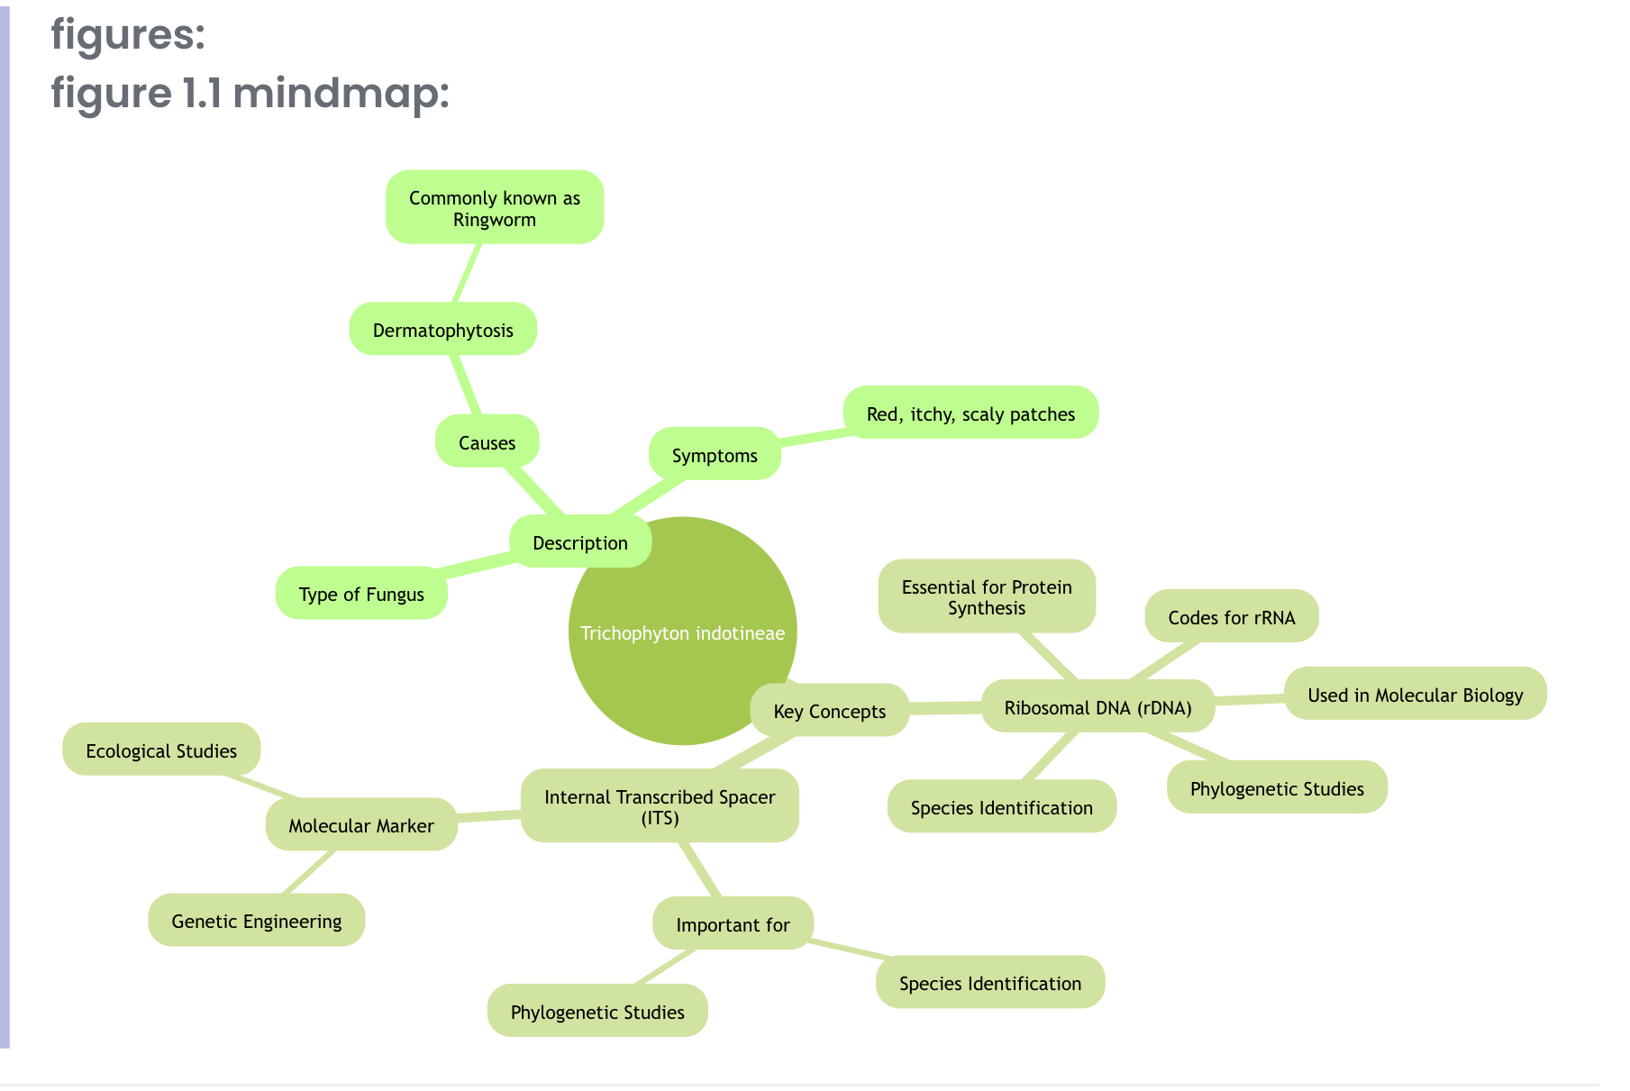

Slide 22
Topic- Monetary policy and unemployment
Was there a threat of recession?
The current consensus regarding monetary policy is to assume a trade-off between unemployment and inflation.
Central banks raise interest rates as inflation rises, reducing investment and hence slowing aggregate demand.
This leads to a reduction in the demand for labour, reducing the ability of wage-earners to push for higher wages, and ease inflationary pressures.
There is, of course, a lot to debate regarding the proper conduct of monetary policy.

Slide 23
Several have criticised the normal conduct of monetary policy, stressing that solving inflation by increasing unemployment represents an unfair burden being placed on workers everywhere, who are already grappling with a cost-of-living crisis.
The rise in unemployment rates triggered the “Sahm rule” which mandates the automatic disbursal of unemployment checks to households when the increase in unemployment rates breaches a certain threshold.
This measure is not an indicator that the economy has entered recession, but is correlated with one.

Slide 24
The carry trade
On the other side of the world, Asian markets were rattled by the increase in interest rates by the Japanese Central Bank following long periods of low rates.
A long period of economic slowdown in Japan has led to central banks keeping interest rates at levels close to 0. Low Japanese interest rates have led to what is known as the “carry trade”, where foreign investors take advantage of low rates to borrow from Japan and invest in foreign markets.
The increase in interest rates caused a disruption in this form of trade, leading to investors selling stocks in other markets to deal with higher borrowing costs.

Slide 25
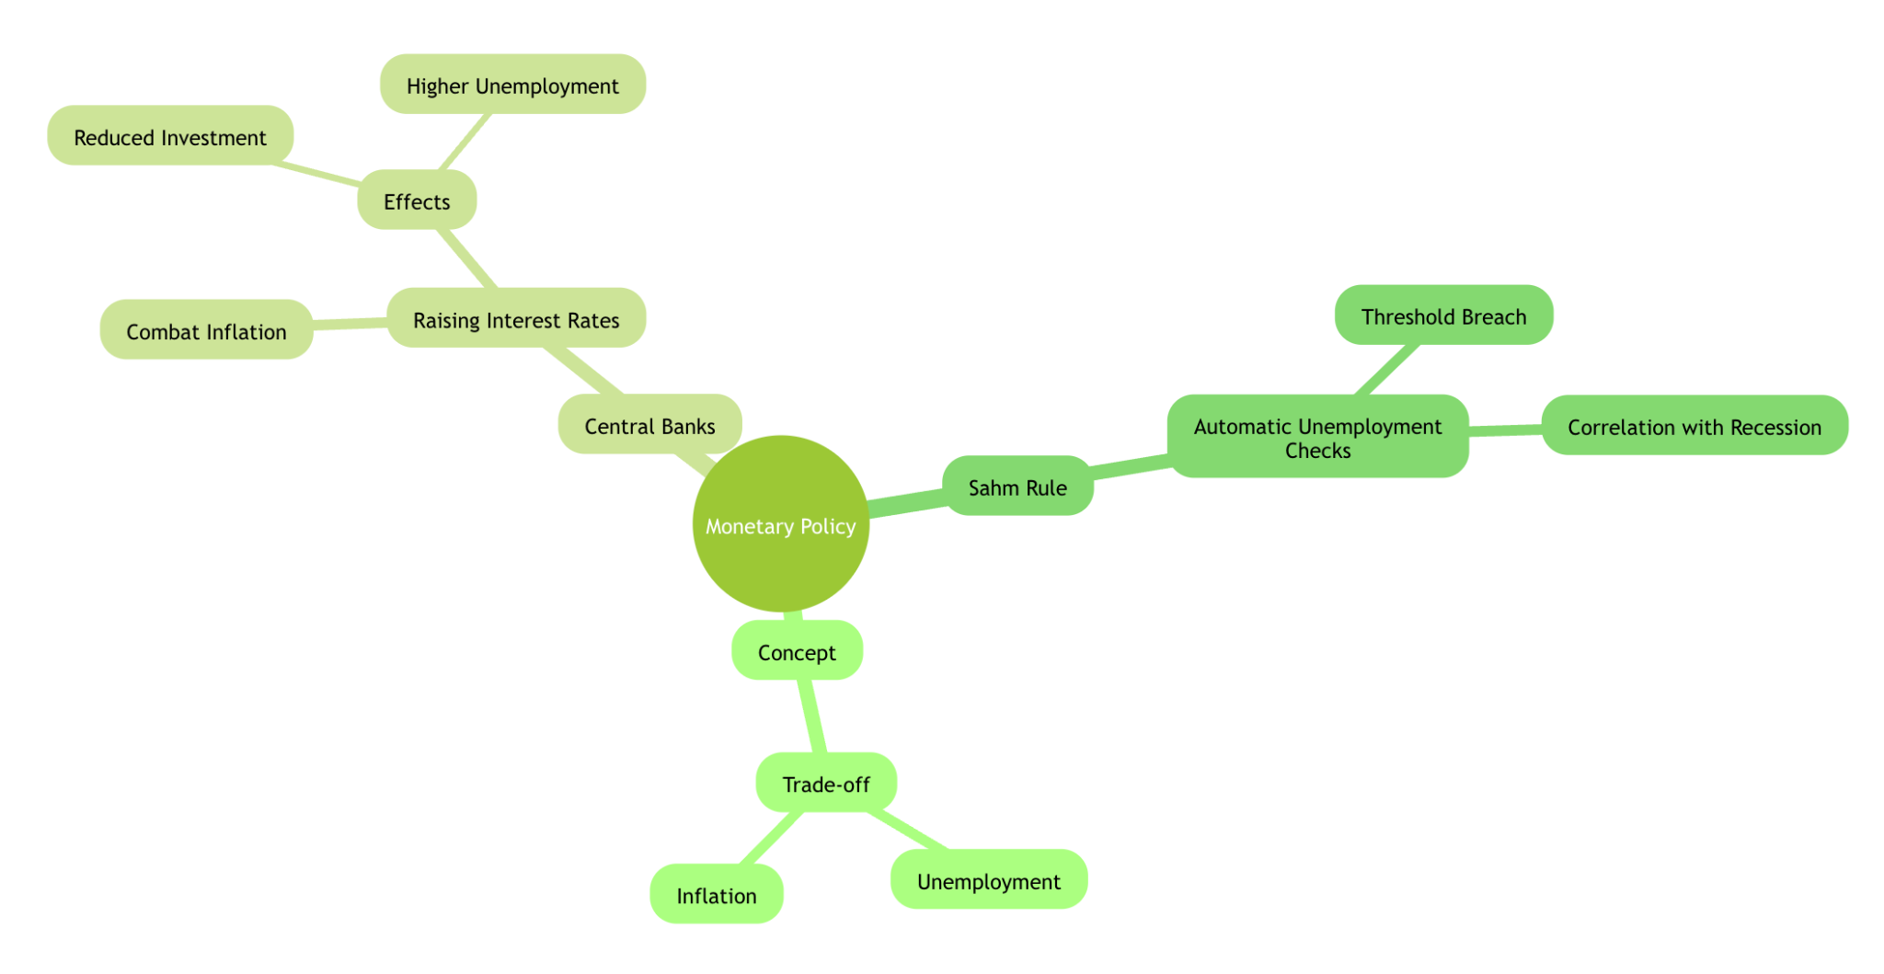

Slide 26
Topic- Development on himalayan Region
What is happening in IHR towns?
Almost all Himalayan towns, including State capitals, struggle with managing civic issues.
For example, cities like Srinagar, Guwahati, Shillong, and Shimla, as well as smaller towns, face significant challenges in managing sanitation, solid and liquid waste, and water.
Planning institutions in these States often fail because they use models copied from the plains and have only limited capacities to implement these plans.

Slide 27
Why is this happening?
The IHR faces increasing pressure from urbanisation and development, compounded by high-intensity tourism, unsustainable infrastructure, and resource use (land and water), further aggravated by climatic variations like changing precipitation patterns and rising temperatures.
This has led to water scarcity, deforestation, land degradation, biodiversity loss, and increased pollution, including plastics.
These pressures have the potential to disrupt lives and livelihoods, impacting the socio-ecological fabric of the Himalayas.
Over the past few decades, tourism in the IHR has continued to expand and diversify, with an anticipated average annual growth rate of 7.9% from 2013 to 2023

Slide 28
What needs to be done?
Planning institutions in IHR cities are still guided by land-use principles. Every town needs to be mapped, with layers identifying vulnerabilities from geological and hydrological perspectives. Climate-induced disasters annually erode infrastructures built without such mapping. Therefore, the planning process should involve locals and follow a bottom-up approach.
Consultant-driven urban planning processes should be shelved for Himalayan towns, with the urban design based on climate resilience.

Slide 29
Additionally, none of the cities in the IHR can generate capital for their infrastructure needs.
The Finance Commission must include a separate chapter on urban financing for the IHR.
The high costs of urban services and the lack of industrial corridors place these towns in a unique financial situation. Current intergovernmental transfers from the centre to urban local bodies constitute a mere 0.5% of GDP; this should be increased to at least 1%.

Slide 30
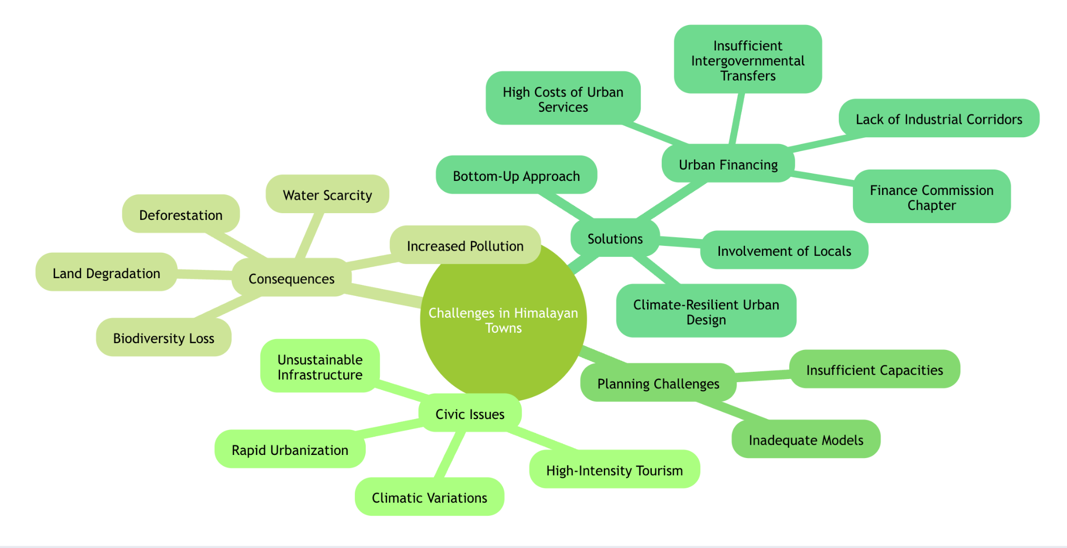

Slide 31

2years coverage

Slide 32

Link in description
Msg -9057921649
Download - saurabh pandey cse app

Slide 33
ALL Advance books for upsc IN ONE COURSE
Starting 1st june
Visit - saurabhpandeyupsc.com
Msg - 9057921649

Slide 34


Slide 35

LIVE

Slide 36

Scan - to get free content

Slide 37

The hindu session pdf
Download the hindu session pdf
Telegram link in description box
Download the hindu pdf - https://t.me/gesreporter
Connect with sir
9057921649

Slide 38
Target Mains -2024/25 -
Q What impact climate change has on monetary policy ??
Connect with sir
9057921649
send your answer - Saurabh pandey upsc telegram channel

