Slide 1

Topics
Biases in brain
Catatumbo lightning
Okavango delta
Model code of conduct
Benefits of bamboo
Starliner
Leprosy
Hurler syndrome
Nitrogen fixation - nitroblast
Mains

Slide 2
Target Mains -2024/25
Q ‘’Biodiversity in African continent will not remain untouched of global boiling’’ Explain.
प्रश्न ''अफ्रीकी महाद्वीप में जैव विविधता वैश्विक उबाल से अछूती नहीं रहेगी'' स्पष्ट करें
send your answer - Saurabh pandey upsc telegram channel

Slide 3
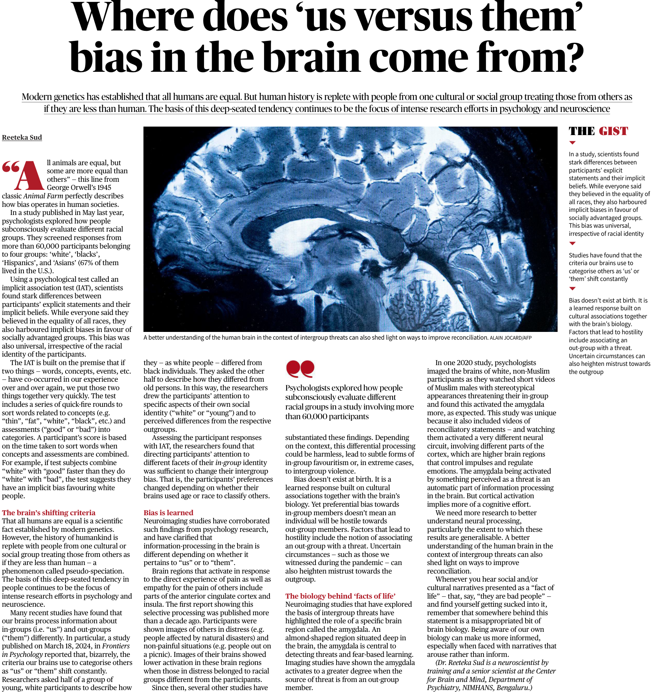

Slide 4
In a study, scientists found stark differences between participants’ explicit statements and their implicit beliefs.
While everyone said they believed in the equality of all races, they also harboured implicit biases in favour of socially advantaged groups.
This bias was universal, irrespective of racial identity Studies have found that the criteria our brains use to categorise others as ‘us’ or ‘them’ shift constantly Bias doesn’t exist at birth.

Slide 5
It is a learned response built on cultural associations together with the brain’s biology.
Factors that lead to hostility include associating an out-group with a threat.
Uncertain circumstances can also heighten mistrust towards the outgroup

Slide 6
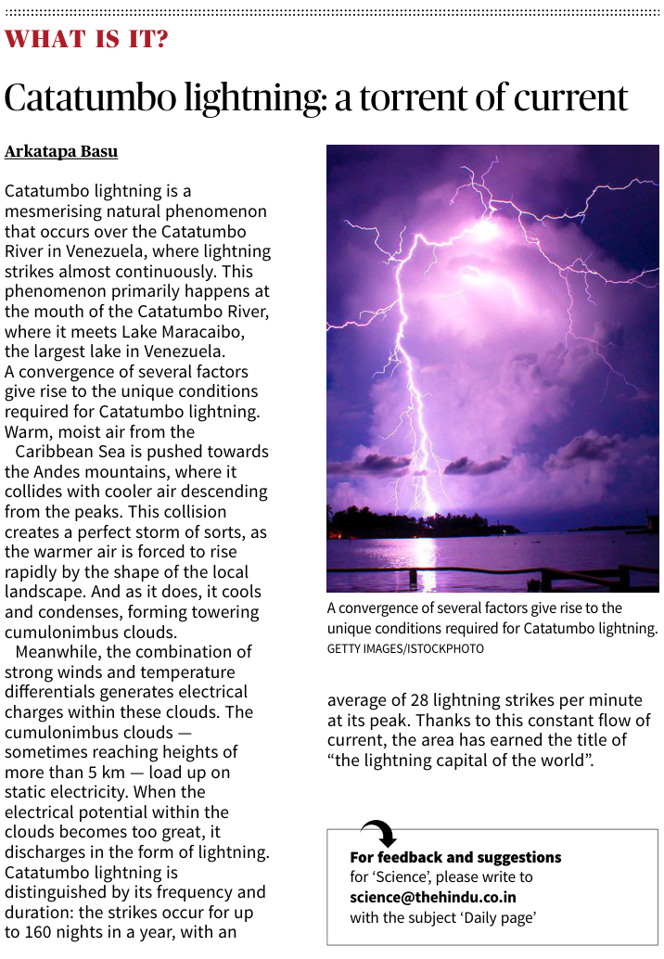

Slide 7
Catatumbo lightning is a mesmerising natural phenomenon that occurs over the Catatumbo River in Venezuela, where lightning strikes almost continuously.
This phenomenon primarily happens at the mouth of the Catatumbo River, where it meets Lake Maracaibo, the largest lake in Venezuela.
A convergence of several factors give rise to the unique conditions required for Catatumbo lightning.

Slide 8
Warm, moist air from the Caribbean Sea is pushed towards the Andes mountains, where it collides with cooler air descending from the peaks.
This collision creates a perfect storm of sorts, as the warmer air is forced to rise rapidly by the shape of the local landscape.
And as it does, it cools and condenses, forming towering cumulonimbus clouds. Meanwhile, the combination of strong winds and temperature differentials generates electrical charges within these clouds.

Slide 9
The cumulonimbus clouds — sometimes reaching heights of more than 5 km — load up on static electricity.
When the electrical potential within the clouds becomes too great, it discharges in the form of lightning

Slide 10
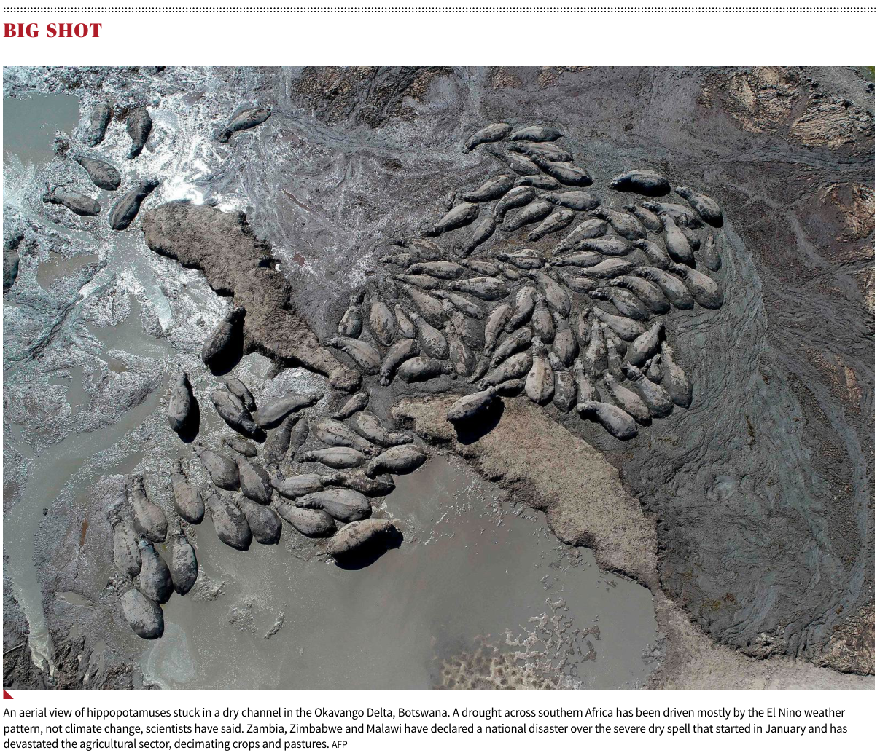

Slide 11
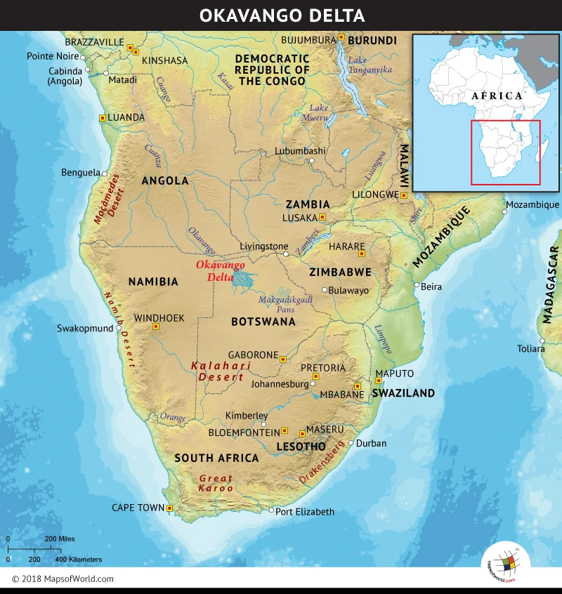

Slide 12
An aerial view of hippopotamuses stuck in a dry channel in the Okavango Delta, Botswana.
A drought across southern Africa has been driven mostly by the El Nino weather pattern, not climate change, scientists have said.
Zambia, Zimbabwe and Malawi have declared a national disaster over the severe dry spell that started in January and has devastated the agricultural sector, decimating crops and pastures

Slide 13
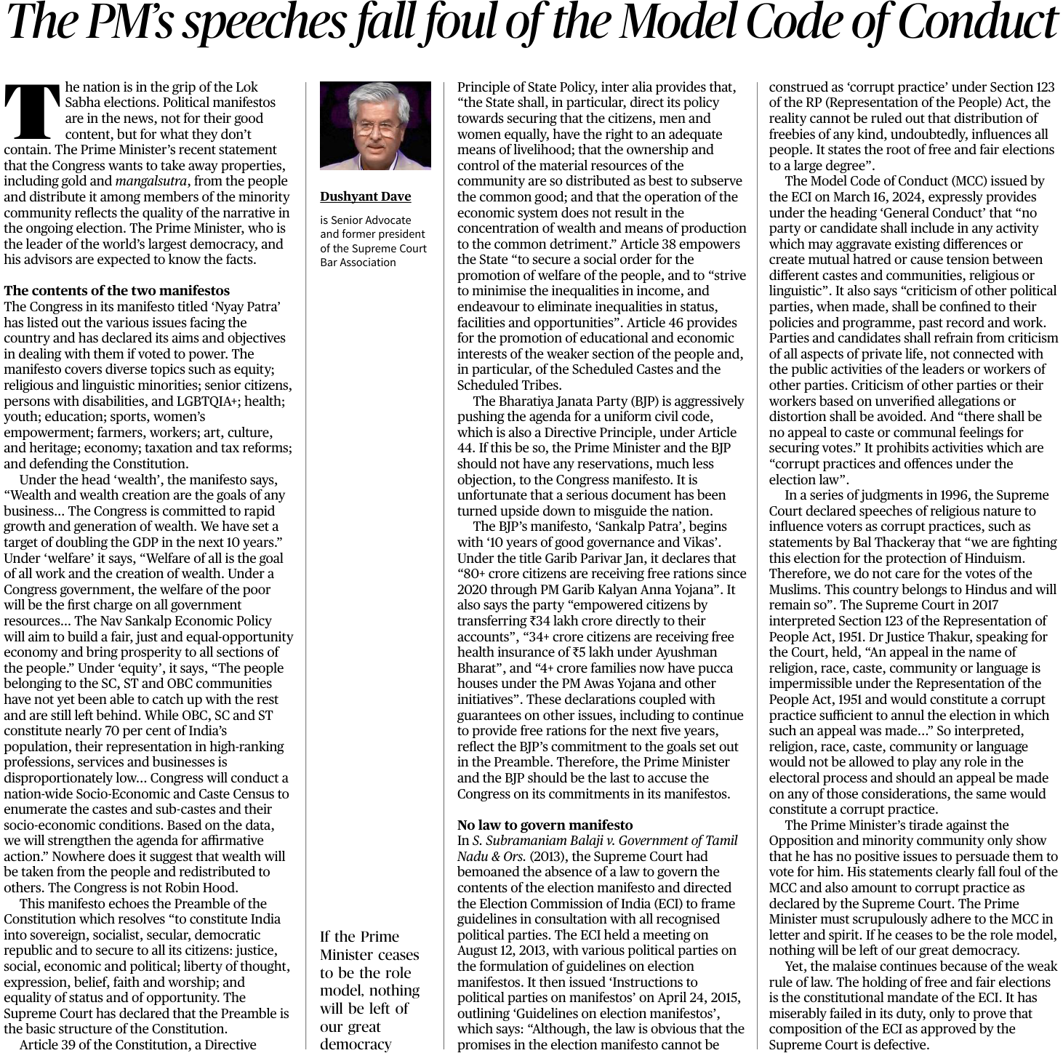

Slide 14
Article 46 provides for the promotion of educational and economic interests of the weaker section of the people and, in particular, of the Scheduled Castes and the Scheduled Tribes.
In S. Subramaniam Balaji v. Government of Tamil Nadu & Ors. (2013), the Supreme Court had bemoaned the absence of a law to govern the contents of the election manifesto and directed the Election Commission of India (ECI) to frame guidelines in consultation with all recognised political parties.

Slide 15
The ECI held a meeting on August 12, 2013, with various political parties on the formulation of guidelines on election manifestos.
It then issued ‘Instructions to political parties on manifestos’ on April 24, 2015, outlining ‘Guidelines on election manifestos’, which says: “Although, the law is obvious that the promises in the election manifesto cannot be construed as ‘corrupt practice’ under Section 123 of the RP (Representation of the People) Act, the reality cannot be ruled out that distribution of freebies of any kind, undoubtedly, influences all people.
It states the root of free and fair elections to a large degree”.

Slide 16
The Model Code of Conduct (MCC) issued by the ECI on March 16, 2024, expressly provides under the heading ‘General Conduct’ that “no party or candidate shall include in any activity which may aggravate existing differences or create mutual hatred or cause tension between different castes and communities, religious or linguistic”

Slide 17
It also says “criticism of other political parties, when made, shall be conned to their policies and programme, past record and work.
Parties and candidates shall refrain from criticism of all aspects of private life, not connected with the public activities of the leaders or workers of other parties.
Criticism of other parties or their workers based on unverified allegations or distortion shall be avoided.
And “there shall be no appeal to caste or communal feelings for securing votes.”
It prohibits activities which are “corrupt practices and offences under the election law”.

Slide 18
In a series of judgments in 1996, the Supreme Court declared speeches of religious nature to inuence voters as corrupt practices.
The Supreme Court in 2017 interpreted Section 123 of the Representation of People Act, 1951. Dr Justice Thakur, speaking for the Court, held, “An appeal in the name of religion, race, caste, community or language is impermissible under the Representation of the People Act, 1951 and would constitute a corrupt practice sufficient to annul the election in which such an appeal was made...”

Slide 19
So interpreted, religion, race, caste, community or language would not be allowed to play any role in the electoral process and should an appeal be made on any of those considerations, the same would constitute a corrupt practice

Slide 20
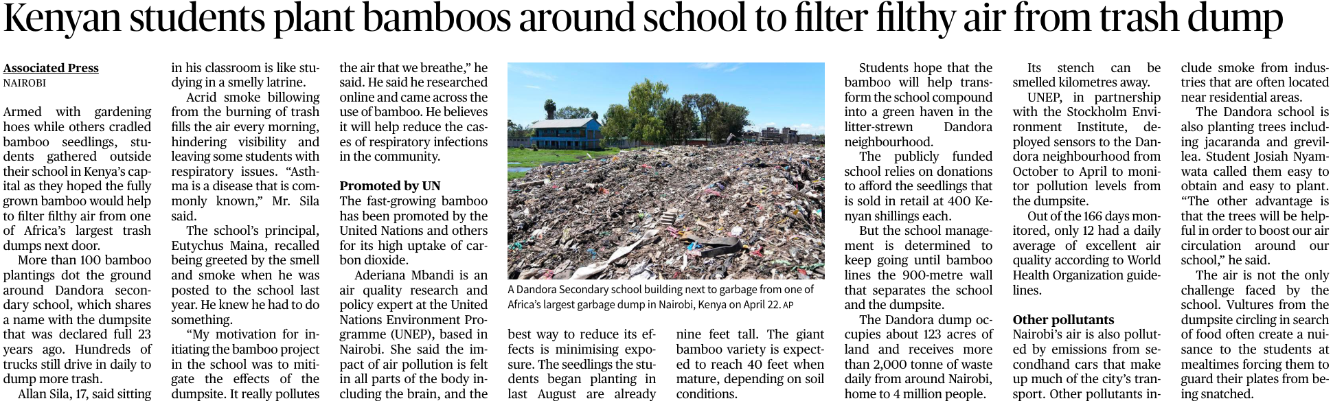

Slide 21
The fast-growing bamboo has been promoted by the United Nations and others for its high uptake of carbon dioxide.
The Bamboos (Bambusoidaea) consists of 1439 different species in 116 genera.
It is one of the 12 subfamilies of the grass family (Poaceae) and the only one to diversify in forests. Bamboo is a great plant for individuals concern with a green environment.

Slide 22
Bamboo is the fastest growing plant on this planet.
It has been recorded growing at an amazing 47.6 inches in a 24 hour period.
Bamboo is a crucial element in the balance of oxygen and carbon dioxide in the atmosphere.
A grove of bamboo release 35% more oxygen than an equivalent stand of trees. Because of this, planting bamboo is a great way to reduce your carbon footprint and help fight global warming.

Slide 23
Bamboo is a viable replacement for wood. It can be harvest in 3-5 years versus 10-20 for most softwoods.
It can out yield pine 6 to 1 in biomass production.
It is also one of the strongest building materials with a tensile strength of 28,000 psi. To help give you an idea how much this is, mild steel measures 23,000 psi.
It is a great soil conservation tool. It greatly reduces erosion with a sum of stem flow rate and canopy intercept of 25%

Slide 24


Slide 25
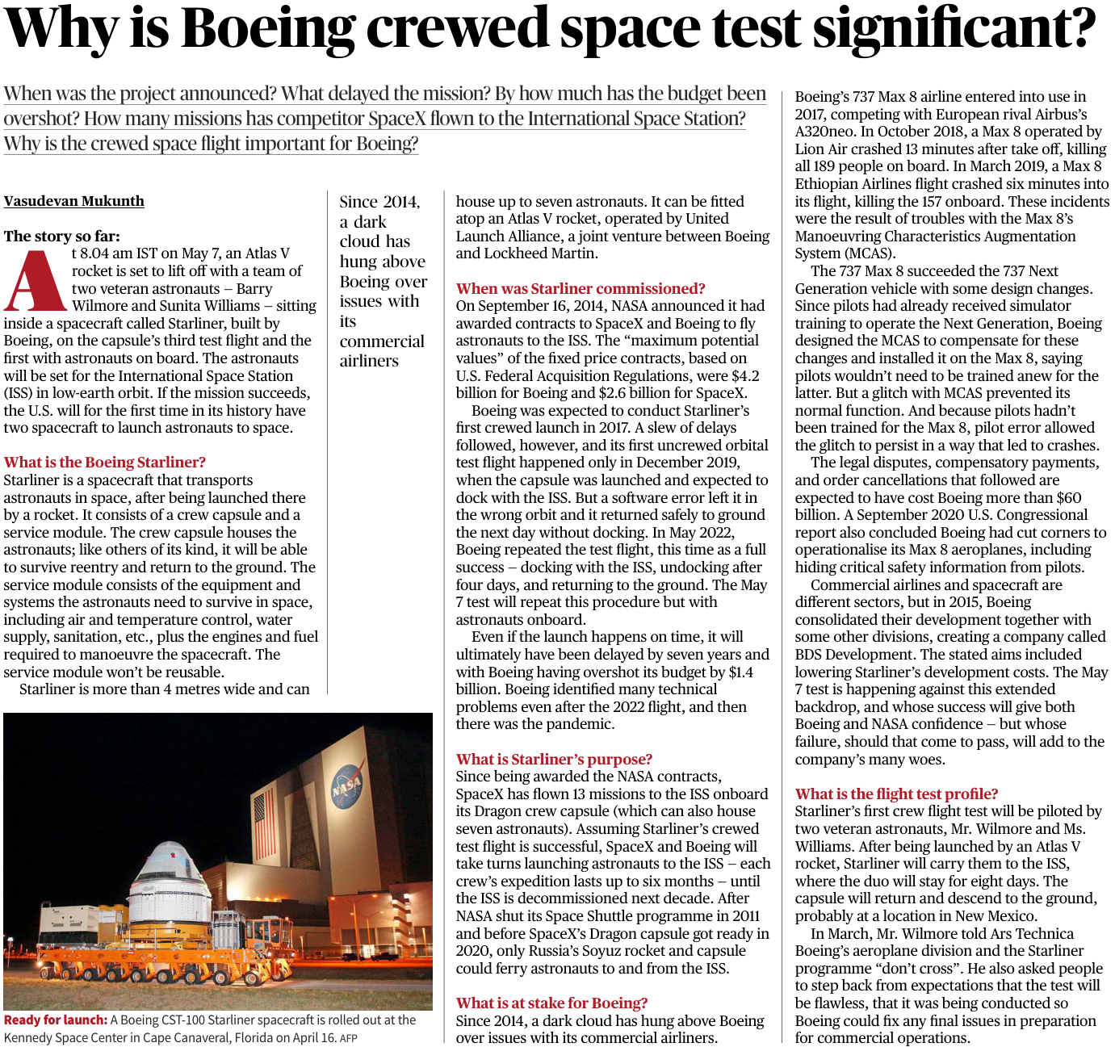

Slide 26
Boeing is finally poised to launch astronauts to the International Space Station for NASA.
Starliner is a spacecraft that transports astronauts in space, after being launched there by a rocket.
It consists of a crew capsule and a service module.
The crew capsule houses the astronauts; like others of its kind, it will be able to survive reentry and return to the ground.
The service module consists of the equipment and systems the astronauts need to survive in space, including air and temperature control, water supply, sanitation, etc., plus the engines and fuel required to manoeuvre the spacecraft. The service module won’t be reusable.

Slide 27
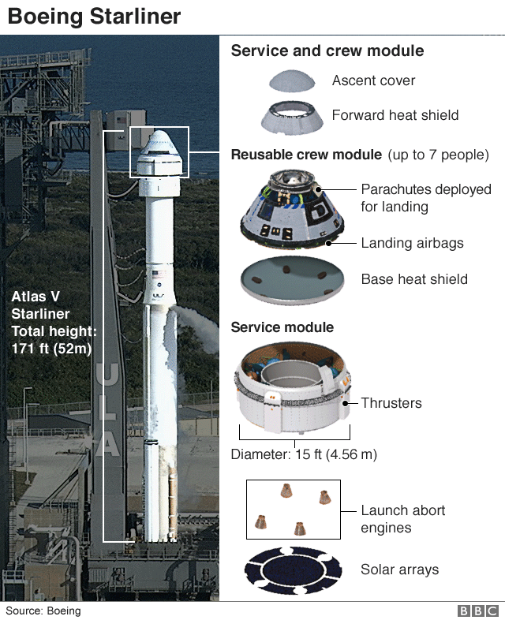

Slide 28
What is Starliner’s purpose?
Since being awarded the NASA contracts, SpaceX has flown 13 missions to the ISS onboard its Dragon crew capsule (which can also house seven astronauts).
Assuming Starliner’s crewed test flight is successful, SpaceX and Boeing will take turns launching astronauts to the ISS — each crew’s expedition lasts up to six months — until the ISS is decommissioned next decade.

Slide 29
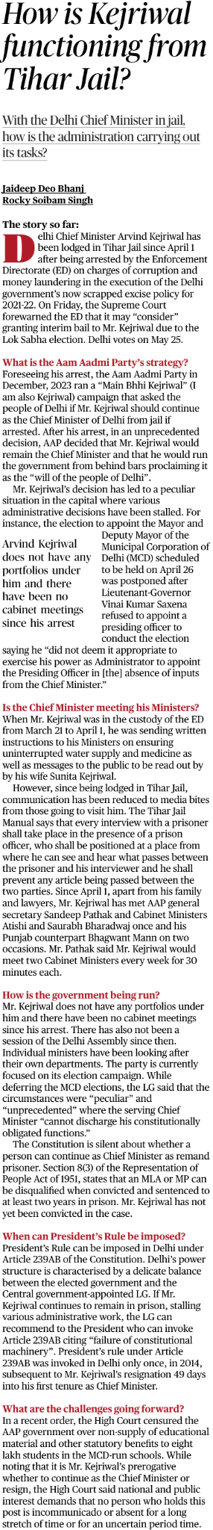

Slide 30
When can President’s Rule be imposed?
President’s Rule can be imposed in Delhi under Article 239AB of the Constitution. Delhi’s power structure is characterised by a delicate balance between the elected government and the Central government-appointed LG.
If Mr. Kejriwal continues to remain in prison, stalling various administrative work, the LG can recommend to the President who can invoke Article 239AB citing “failure of constitutional machinery”.
President’s rule under Article 239AB was invoked in Delhi only once, in 2014, subsequent to Mr. Kejriwal’s resignation 49 days into his first tenure as Chief Minister.

Slide 31
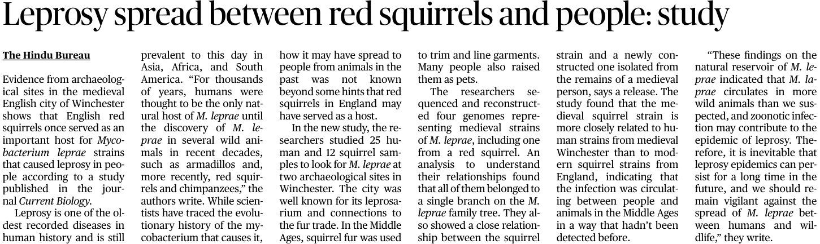

Slide 32
Red squirrels once served as an important host for Mycobacterium leprae strains that caused leprosy in people .

Slide 33
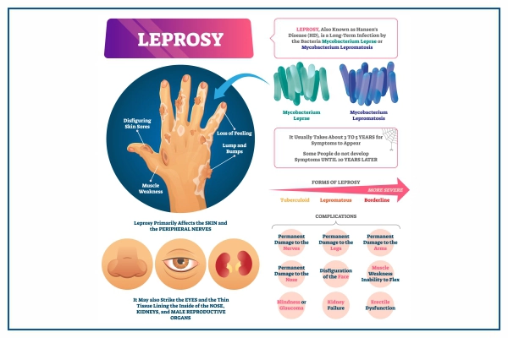

Slide 34
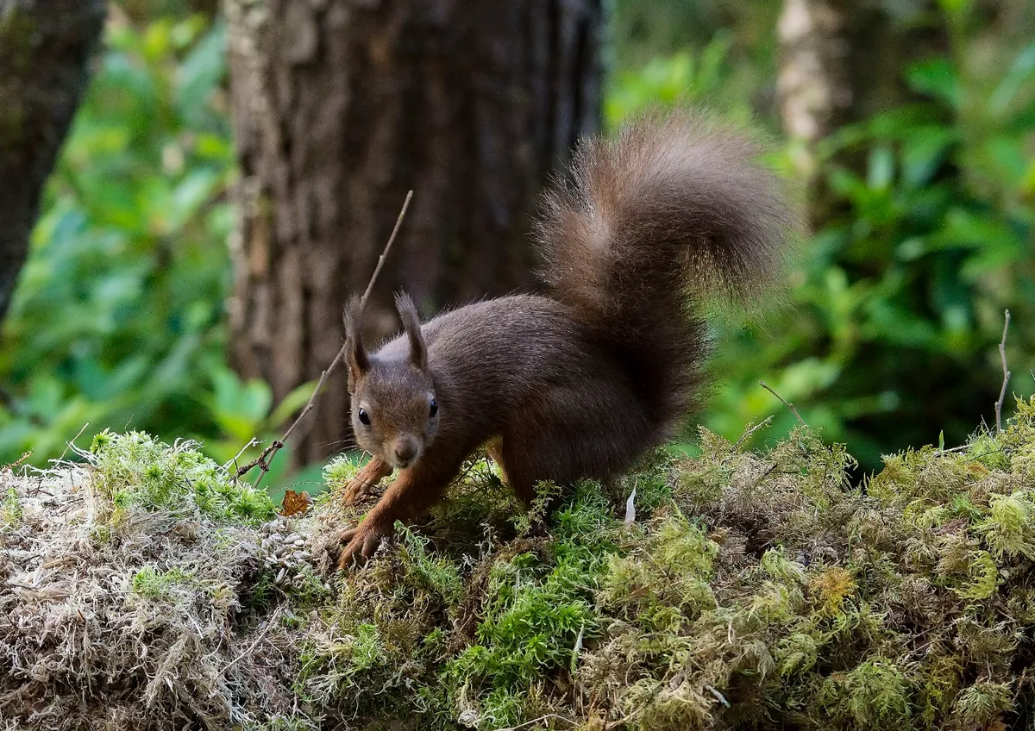
Red squirrels are a small mammal which falls under a rodent group called Sciuridae (meaning shadow-tailed).
Examples of the squirrel family includes tree squirrels, ground squirrels and flying squirrels.

Slide 35
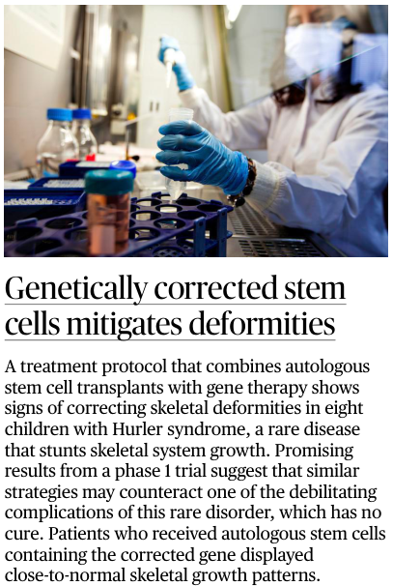

Slide 36
A treatment protocol that combines autologous stem cell transplants with gene therapy shows signs of correcting skeletal deformities in eight children with Hurler syndrome, a rare disease that stunts skeletal system growth.

Slide 37
Hurler syndrome is a rare autosomal recessive lysosomal storage disorder.
Affected individuals demonstrate typical coarse facial features including a flat nasal bridge and excessive hair growth.
Usually manifests as cognitive developmental delay, corneal clouding, cardiac disease, and characteristics musculoskeletal manifestations

Slide 38
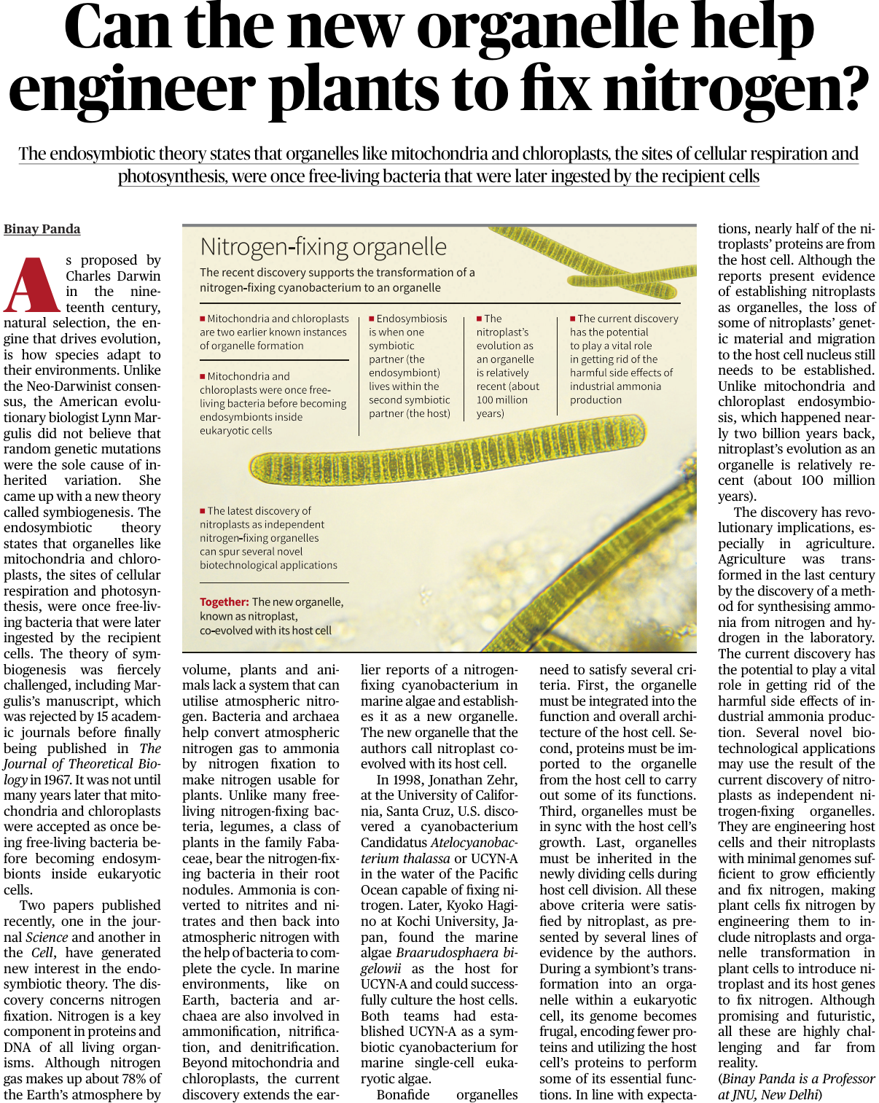

Slide 39
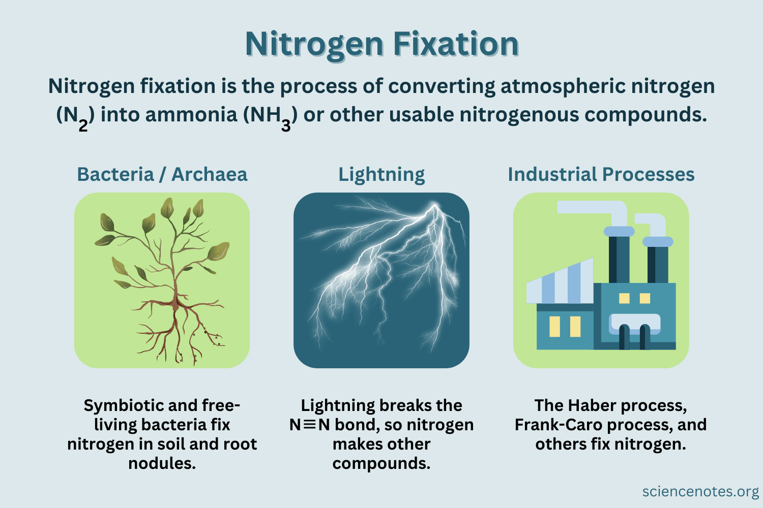

Slide 40
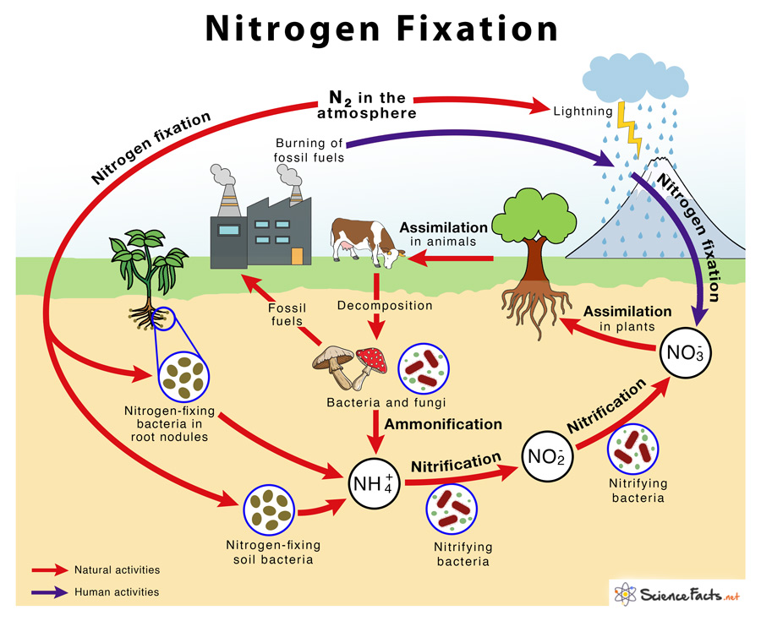

Slide 41
The endosymbiotic theory states that organelles like mitochondria and chloroplasts, the sites of cellular respiration and photosynthesis, were once free-living bacteria that were later ingested by the recipient cells.
Nitrogen is a key component in proteins and DNA of all living organisms. Although nitrogen gas makes up about 78% of the Earth’s atmosphere by volume, plants and animals lack a system that can utilise atmospheric nitrogen.
Bacteria and archaea help convert atmospheric nitrogen gas to ammonia by nitrogen fixation to make nitrogen usable for plants.

Slide 42
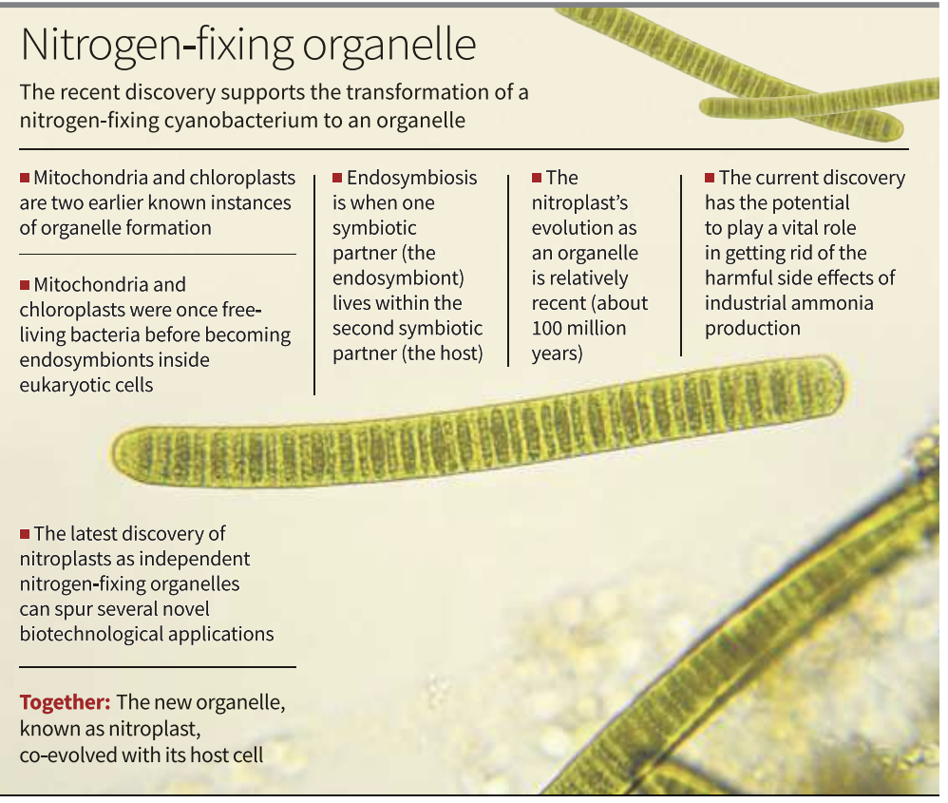

Slide 43
In marine environments, like on Earth, bacteria and archaea are also involved in ammonification, nitrification, and denitrification.
Beyond mitochondria and chloroplasts, the current discovery extends the earlier reports of a nitrogen- fixing cyanobacterium in marine algae and establishes it as a new organelle.
The new organelle that the authors call nitroplast coevolved with its host cell.

Slide 44
Unlike many free living nitrogen-fixing bacteria, legumes, a class of plants in the family Fabaceae, bear the nitrogen-fixing bacteria in their root nodules.
Ammonia is converted to nitrites and nitrates and then back into atmospheric nitrogen with the help of bacteria to complete the cycle.

Slide 45
The discovery has revolutionary implications, especially in agriculture. Agriculture was transformed in the last century by the discovery of a method for synthesising ammonia from nitrogen and hydrogen in the laboratory.
The current discovery has the potential to play a vital role in getting rid of the harmful side effects of industrial ammonia production.
Several novel biotechnological applications may use the result of the current discovery of nitroplasts as independent nitrogen-fixing organelles.

Slide 46
They are engineering host cells and their nitroplasts with minimal genomes sufficient to grow efficiently and fix nitrogen, making plant cells fix nitrogen by engineering them to include nitroplasts and organelle transformation in plant cells to introduce nitroplast and its host genes to fix nitrogen

Slide 48
Courses for 2024 prelims (40 PER OFF TODAY)
1- PT 730 - 2YRS CURRENT AFFAIRS
2- INTERNATIONAL RELATIONS
3- Agriculture for GS
4- Advance topics of science tech
5- prelims vijay series ( 10 full length testS)
9057921649
Visit - saurabhpandeyupsc.com

Slide 49
Target Mains -2024/25
Q ‘’Biodiversity in African continent will not remain untouched of global boiling’’ Explain.
प्रश्न ''अफ्रीकी महाद्वीप में जैव विविधता वैश्विक उबाल से अछूती नहीं रहेगी'' स्पष्ट करें
send your answer - Saurabh pandey upsc telegram channel

